Slide 1
Decision Trees

Slide 2
🌳 What is a Decision Tree?
Decision Trees are trees (not necessarily binary) whose edges denote a decision At each step (or node), the tree asks a simple yes/no question about the data to help it decide what to do next.
🧠 Why do we use it?
It's a very simple and easy-to-understand machine learning model.
It can handle both numbers (like age, salary) and categories (like gender, city).
It's the base for more powerful models like Random Forest and XGBoost.

Slide 3
How does it work?
Let’s imagine we’re trying to predict if a person will buy a product. We might ask questions like:
Is their age > 40? Is their income > ₹50,000? Do they live in a metro city?
At each step, we split the data into groups based on the answer to one question.
The goal is to make each group more similar (homogenous) in terms of what we're trying to predict.
🔍 Why make groups more homogenous?
Because if each group contains mostly one type of output (e.g., mostly people who buy), the tree can make better predictions.
So, we want our splits to increase the "purity" of the data.

Slide 4
How do we measure this "purity"?
We use formulas like:
Gini Index
Entropy
These tell us how mixed up the group is. 👉 Lower the mix (i.e., more homogenous), better the group.
⚖️ How do we choose the best question?
We try different questions and calculate something called Information Gain for each one.
💡 Information Gain = How much better (purer) the split becomes after asking the question.
Whichever question gives the highest gain, we choose that one.

Slide 5
What happens next?
Ask the best question → Split the data.( Best question is decided by the highest information gain that can be achieved)
Repeat the process on each new group.
Stop splitting when:
The data is "pure enough" — meaning most items in the group belong to the same class.
Or we hit limits like:
Maximum tree depth
Minimum number of samples in a node
Minimum improvement in Information Gain
These limits help the tree stay general and avoid just memorizing the training data (which is called overfitting).

Slide 6
What is Overfitting?
Overfitting happens when a model learns the training data too well, including all the noise, outliers, and random fluctuations.
It makes perfect predictions on the training data.
But it fails badly on new, unseen data.
It’s like a student who memorizes every question and answer from the practice paper, but can’t handle a slightly different question in the real exam.

Slide 7
Why are Decision Trees more prone to overfitting?
Because they are naturally greedy — they try to split the data in a way that makes each group as pure as possible.
That means if you don’t control them, they might:
Keep splitting the data again and again
Until each leaf node has just one data point
Which means 100% purity, but also zero generalization
They end up memorizing instead of learning patterns.

Slide 8
How do we prevent overfitting in Decision Trees?
We use hyperparameters — these are settings we can tweak while building the tree.
They act like limits that tell the tree when to stop or slow down.
1. max_depth
Limits how deep the tree can grow.
Prevents the model from splitting too many times.
"max_depth":(list(range(1, 20))),
2. min_samples_split
The minimum number of samples needed to split a node.
Higher value → less splitting → simpler tree.
"min_samples_split":[2, 3, 4],
3. min_samples_leaf
The minimum number of samples that must be in a leaf node.
Helps avoid tiny, over-specialized branches.
"min_samples_leaf":list(range(1, 20)),

Slide 9
4. max_leaf_nodes
Caps the total number of leaf nodes in the tree.
Limits complexity and overfitting.
5. max_features
The number of features to consider when looking for the best split.
Using fewer features makes the model more robust and less likely to overfit.
'max_features': ['sqrt', 'log2', None, 0.5, 0.75, 5],
6. criterion
The function used to measure the quality of a split: 🔹 "gini" → Gini impurity 🔹 "entropy" → Information gain
7. splitter
Controls how we find the best place to split a node
"splitter":("best", "random"),
Best - Try all options, pick the best (Good for accuracy) ; random - Try a random subset of options (good for Speed & ensembles)

Slide 10
Random Forest

Slide 11
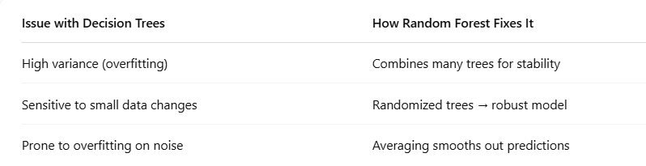
Random Forest
What is a Random Forest?
An ensemble of multiple Decision Trees
Each tree sees a random subset of data and features
Final prediction is made by:
Majority voting (for classification)
Averaging (for regression)
Why use Random Forests? (Intuition: “Don’t trust one tree’s opinion—take a vote from a forest of trees trained differently.”)

Slide 12
XGBoost
What is XGBoost?
XGBoost stands for Extreme Gradient Boosting.
A boosting algorithm → builds trees sequentially, each fixing errors made by the last.
Known for being super fast, accurate, and regularized.

Slide 13
Random Forest Hyperparameters
All Decision Tree hyperparameters (Like: max_depth, min_samples_split, max_features, etc.) +
1. n_estimators – Number of Trees
The number of decision trees in the Random Forest.
More trees → Better average prediction (to a point).
Low (e.g., 10): Faster training, but might underperform.
Moderate (e.g., 100–200): Good balance for most tasks.
Very high (e.g., 1000+): Can improve slightly, but slows training and increases memory usage.
n_estimators = [200,300,500]
2: bootstrap – Sampling with Replacement
Controls how data is sampled for each tree.
If bootstrap=True, each tree sees a random subset with replacement.
If False, the whole dataset is used to build each tree.
bootstrap = [True, False]

Slide 14
XG Boost

Slide 15
Introduction to XGBoost
What is XGBoost?
XGBoost stands for Extreme Gradient Boosting.
A boosting algorithm → builds trees sequentially, each fixing errors made by the last.
Known for being super fast, accurate, and regularized.
Based on gradient boosting framework
Uses decision trees as weak learners
Each new tree focuses on minimizing previous error
Why Use XGBoost?(or Gradient Boosting)?
Random Forest builds many decision trees independently.(❌ It doesn’t learn from mistakes made by other trees.)
Each tree is trained on a random subset of data and features.(❌ All trees are equally weighted, even bad ones.)
Final output = majority vote (classification) or average (regression). (❌ Can struggle when there's a lot of noise )

Slide 16
How Gradient Boosting (XGBoost) Fixes This:
Sequential Learning:
XGBoost builds trees one by one.
Each new tree is trained to fix the errors of the previous trees.
Trees that focus on hard-to-classify points are prioritized.
Weighted Learning:
Points misclassified in earlier trees are given more focus.
Trees are added in a way that minimizes the overall error (gradient descent).
Controlled Updates:
Uses a learning rate to control how much each tree influences the final result.
Prevents drastic jumps and helps generalization.
Why XGBoost is Better in Many Cases:
Learns from mistakes → more accurate
Less overfitting with regularization
Handles noise better than RF
Customizable — you can fine-tune learning strategy
In short: Random Forest = Many independent trees → good generalization XGBoost = Smart, sequential learning → great at fine-tuning errors

Slide 17
XGBoost Hyperparameters
n_estimators: Total number of trees to build in the boosting process.
→ More trees = better fit (but risk of overfitting if too many).
'n_estimators': [200, 300, 400],
gamma: Minimum loss reduction required to make a split — helps control tree complexity by avoiding unnecessary splits. → Higher gamma = more conservative tree.
'gamma': [0.1, 0.15, 0.2]
learning_rate (a.k.a. eta): Controls how much each new tree contributes to the overall prediction. → Lower value = slower but more robust learning.
'learning_rate': [0.08, 0.1, 0.15],
colsample_bytree: Fraction of features (columns) used when building each tree. (Same as max_featues in Random Forest) → Adds randomness → helps reduce overfitting.
'colsample_bytree': [0.6, 0.8, 1.0],
subsample: Fraction of training data rows randomly sampled for each tree.
→ Adds randomness → helps prevent overfitting.
'subsample': [0.6, 0.8, 1.0],

Slide 18
Logistic Regression

Slide 19
What is Logistic Regression
Despite the name, Logistic Regression is actually a classification algorithm, not a regression algorithm. It’s used to predict categories or classes (mainly for Binary Classification)
Goal : To predict the probability that something belongs to a particular class (e.g., YES or NO).
It outputs a value between 0 and 1, which can be interpreted as a probability.
If the probability is more than 0.5 → Class 1
If the probability is less than 0.5 → Class 0 (Threshold can be changed)
How It Works?
Linear Combination
It first makes a weighted sum of inputs, just like Linear Regression:
z = w₁x₁ + w₂x₂ + ... + wₙxₙ + b
Where:
x₁, x₂... are the input features
w₁, w₂... are weights learned by the model
b is bias

Slide 20

2. Apply Sigmoid Function
This z value is passed into a sigmoid function. This converts the output to a value between 0 and 1 (like a probability).
3. Make a Prediction
If sigmoid(z) > 0.5 → Predict class 1 (e.g., Pass, Yes, Positive)
Else → Predict class 0 (e.g., Fail, No, Negative)
Example:
Imagine you’re predicting whether a student will pass based on study hours.
Student A studied 9 hours → Logistic Regression might output 0.93 → Predict Pass
Student B studied 2 hours → Output 0.18 → Predict Fail
Why Use Logistic Regression?
Very interpretable: You can see the effect of each input.
Fast to train
Works well with linearly separable data
Limitations
Can struggle with non-linear data
Assumes features are independent

Slide 21
Common Hyperparameters
C (Inverse of Regularization Strength)
Explanation: The C parameter controls the amount of regularization applied in logistic regression. A high C means less regularization (the model is more flexible and can fit the training data more closely), while a low C means more regularization (the model is more constrained).
Typical Values: C values range from small (e.g., 0.01, 0.1) to large (e.g., 10, 100). Start with a range and use cross-validation to find the optimal value.
2. Penalty
Explanation: The penalty controls the type of regularization used. The two common options are:
L1 regularization (Lasso): Encourages sparsity, i.e., some weights become exactly zero (helpful for feature selection).
L2 regularization (Ridge): Encourages small weights, but doesn’t set them to zero (more common in logistic regression).
Typical Values: penalty='l1' or penalty='l2'. In most cases, l2 is preferred, but l1 can be used if you want feature selection.
3. class_weight
Explanation: The class_weight parameter adjusts the weight given to each class. It helps when you have imbalanced classes, where one class is much more frequent than the other. By increasing the weight of the minority class, the model pays more attention to it.
Typical Values:
class_weight='balanced': Automatically adjusts the weights inversely proportional to class frequencies in the input data.
Or you can manually assign a dictionary, e.g., class_weight={0: 1, 1: 2}, where class 1 has more weight.

Slide 22
Handling Class Imbalance

Slide 23
Handling Imbalanced Data in Classification
Problem
In imbalanced datasets, one class dominates the other (e.g., 95:5).
Classifiers tend to get biased towards the majority class.
Leads to poor performance on the minority class (which is often the most important one).
🛠️ Common Fix: Resampling
Resampling is used to balance the class distribution.
Two main approaches:
Undersampling: Remove samples from the majority class.
Oversampling: Add samples to the minority class.
Undersampling Problem;
Can discard useful data → loss of information.
Hence, oversampling is preferred in most cases.

Slide 24
SMOTE – Synthetic Minority Oversampling Technique
What is SMOTE?
SMOTE generates synthetic data points for the minority class.
Avoids overfitting caused by just duplicating existing points.
How SMOTE Works:
Choose how many synthetic samples (N) to generate.
For each sample in the minority class:
Find its k nearest neighbors (usually k = 5).
Randomly select N neighbors from these.
For each selected neighbor:
Compute the difference vector between the sample and neighbor.
Multiply it by a random number (0,1].
Add this to the original vector → creates a new synthetic sample.
Benefits:
Improves minority class recall.
Helps model generalize better than naive oversampling.

Slide 25
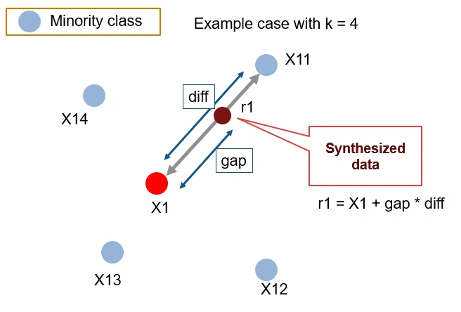
https://www.analyticsvidhya.com/blog/2020/10/overcoming-class-imbalance-using-smote-techniques/ - To learn more about techniques used for handling class imbalance

